Slide 1
NYU 6463 PROCESSOR
BY:
DAN WU
KUSH AGARWAL
MADHUMITA SAWANT
MONICA REDDY TIRUPARI
SHUBHAM MAHALANK
XINMEI JIN
ZHAOXI CHEN

Slide 2
PROGRESS SO FAR:
Block Diagram
VHDL code of the complete processor and its individual components.
Functional Simulation of Individual modules.
Functional Simulation of the complete integrated Processor.
Simulation of the two sample codes provided.
RC5 code in assembly.
RC5 assembly code to machine code using the processor’s ISA.
Timing Simulation of the Integrated Processor.

Slide 3
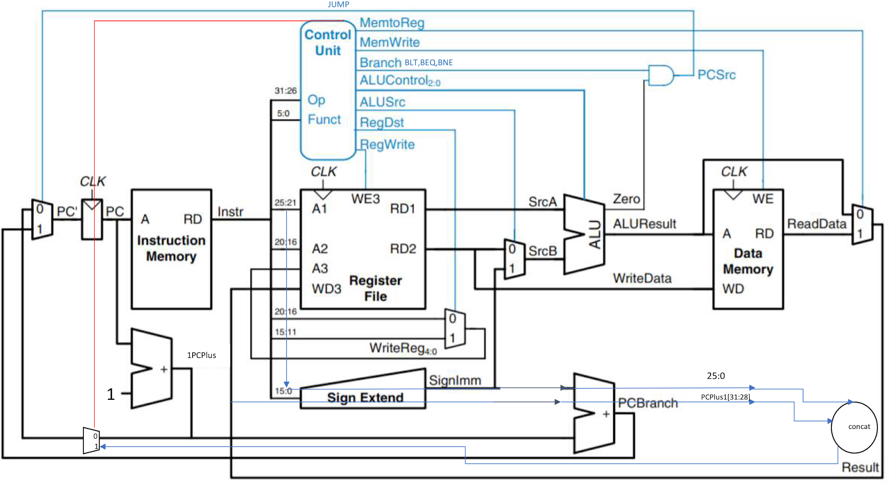
BLOCK DIAGRAM OF NYU-6463 PROCESSOR

Slide 4
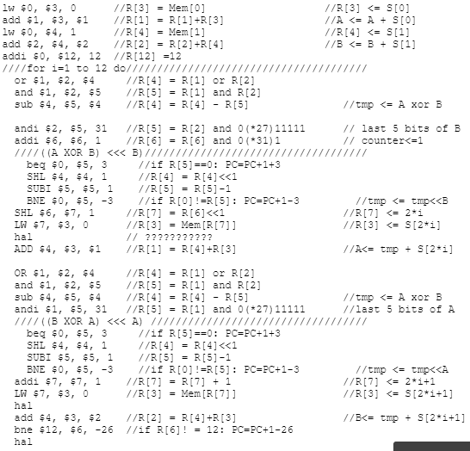
RC5 ASSEMBLY
Data Mem:
Mem[0] to Mem[25] store Skey
Mem[26] to Mem[29] store Ukey
RF:
R[1] represent A
R[2] represent B

Slide 5
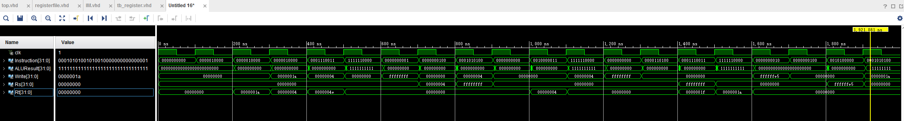
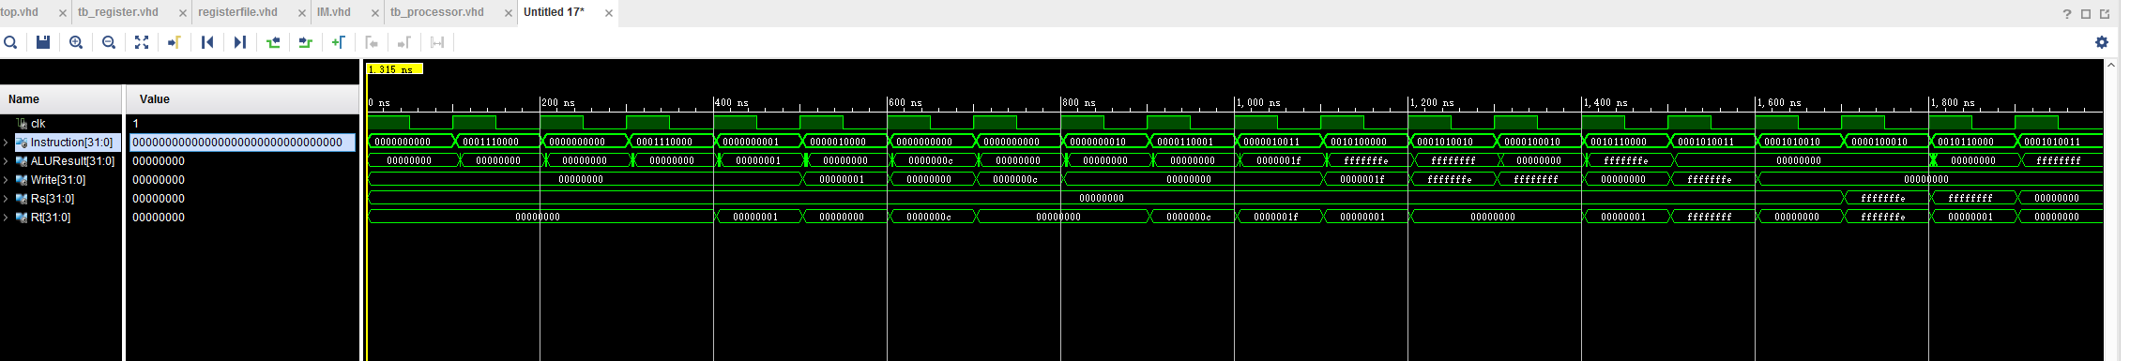
SIMULATION OF THE NYU-6463 PROCESSOR
Key_exp:
Rc5_enc:
Rc5_dec:

Slide 6
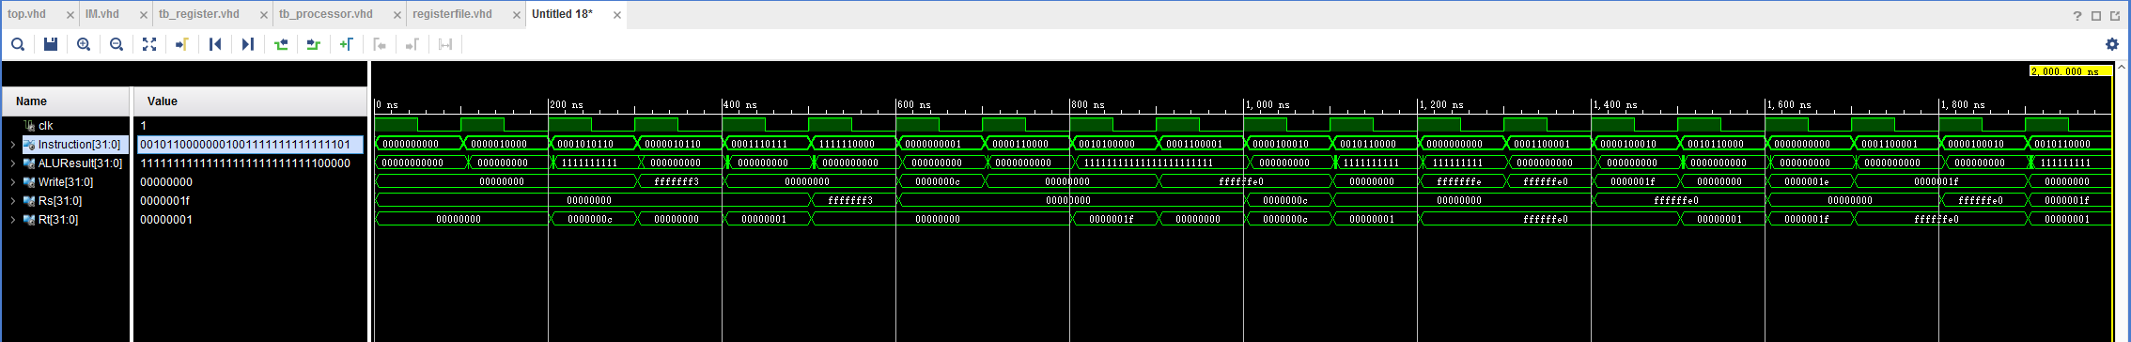
SIMULATION OF THE NYU-6463 PROCESSOR
Rc5_dec:

Slide 7
TASKS TO BE COMPLETED:
Actual FPGA Simulation
Timing Simulation of the Intergrated Processor running the RC5 Code.

